Slide 1
Collegiate Academy/Dual Enrollment
Important Information
D. Pham
Notes:
hi everyone in this presentation we will be talking about everything you need to know for collegiate acad or de

Slide 2
Topics Covered
Collegiate requirements
PERT (Requirements and retake) (ACT and PSAT equivalent)
AA requirements
AICE/AP equivalent and sending scores
HS equivalent
Finding classes to take (Each term)
Signing up for classes (Via Form B)
Ordering textbooks
Checking progress
Meeting with an advisor at HCC
Notes:
These are the topics that will be covered in the presentation, things like requirements to take dual enrollment classes and how to register for classes

Slide 3
The PERT
You'll take the PERT at the end of your freshman year if you're a Collegiate student
You can take the PERT anytime on HCC campus or online!
To take any further DE classes, you will need PERT scores
For the math scores:
Go for the 114 if you plan to take Topics in Math/Exploration in Math
Go for the 123 if you plan to take College Algebra/Trigonometry
*If you are unsure what you would like to take, check what your future major requires and decide from there.
The first PERT test will be in March/ April and there will be two retakes after that.
Notes:
The PERT this is the most important thing you need to do in order to be eligible to take DE classes regardless if you are collegiate or not
...for the math score there are different requirements depending on what classes you want to take
it all depends on what classes you want to take afterwards or what your future major requires
for ex:

Slide 4
PERT/PSAT/ACT Scores Requirement
 | PERT | Digital PSAT | ACT
READING | 106 | 490 | 19
WRITING | 103 | N/A | 17
MATH | 114 | 480 | 19
MATH (MAC 1105) | 123 | 530 | 21
Notes:
these are the psat and act equivalents to the pert, if you have these scores from the psat you do not have to take the pert

Slide 5
Collegiate/Dual Enrollment Requirements
Hitting PERT benchmarks
- Reading Score: 106
- Writing Score: 103
- Math Score: 114 (for MGF) or 123 (for MAC)
2. Maintaining a 3.0 unweighted high school GPA and a 2.0 HCC GPA to remain eligible.
3. Actively taking DE courses.

Slide 6
AA General Education Requirements
Communications (9 Credits)
-ENC 1101 and ENC 1102
-SPC 1608
Humanities (6 Credits)
Mathematics (6 Credits)
Behavioral Science (3 Credits)
History (3 Credits)
Social Science (3 Credits)
Biological Science (3 Credits)
Physical Science (3 Credits)
Electives (24 Credits)
IDS 2981 (1)
CGS 2100 (3)
2 Foreign Language (8)
SLS 1106 (3)
Lab Credit (1)
The other 8 elective credits are up to you! (AP or AICE can satisfy this requirement!)

Slide 7
Example AA Pathway
Classes in green will most likely be part of your schedule at Leto.
Classes in blue can be tested out of through AICE /AP Scores.
Classes in red you might have to take online at HCC.
Humanities (6 Credits)
-HUM 1020, and LIT 2000 or PHI 1010
History (3 Credits)
- AMH 2010
Behavioral Science (3 Credits)
- PSY 2012
Social Science (3 Credits)
- AMH 2020
Physical Science (3 Credits)
- AST 1002C
Biological Science (3 Credits)
-BSC 1005
Mathematics (6 Credits)
-MAC 1105 and MAC 1114 OR
-MGF 1106 and MGF 1107
Communications (9 Credits)
-ENC 1101 and ENC 1102
-SPC 1608
Electives (24 Credits)
IDS 2981 (1)
CGS 2100 (3)
2 Foreign Language (8)
-SPN 1120 and 1121
SLS 1106 (3)
BSC 1005 Lab (1)
This gives you 16 out of 24 credits, the other 8 can be earned through test scores on AICE/AP or by taking more HCC classes.

Slide 8
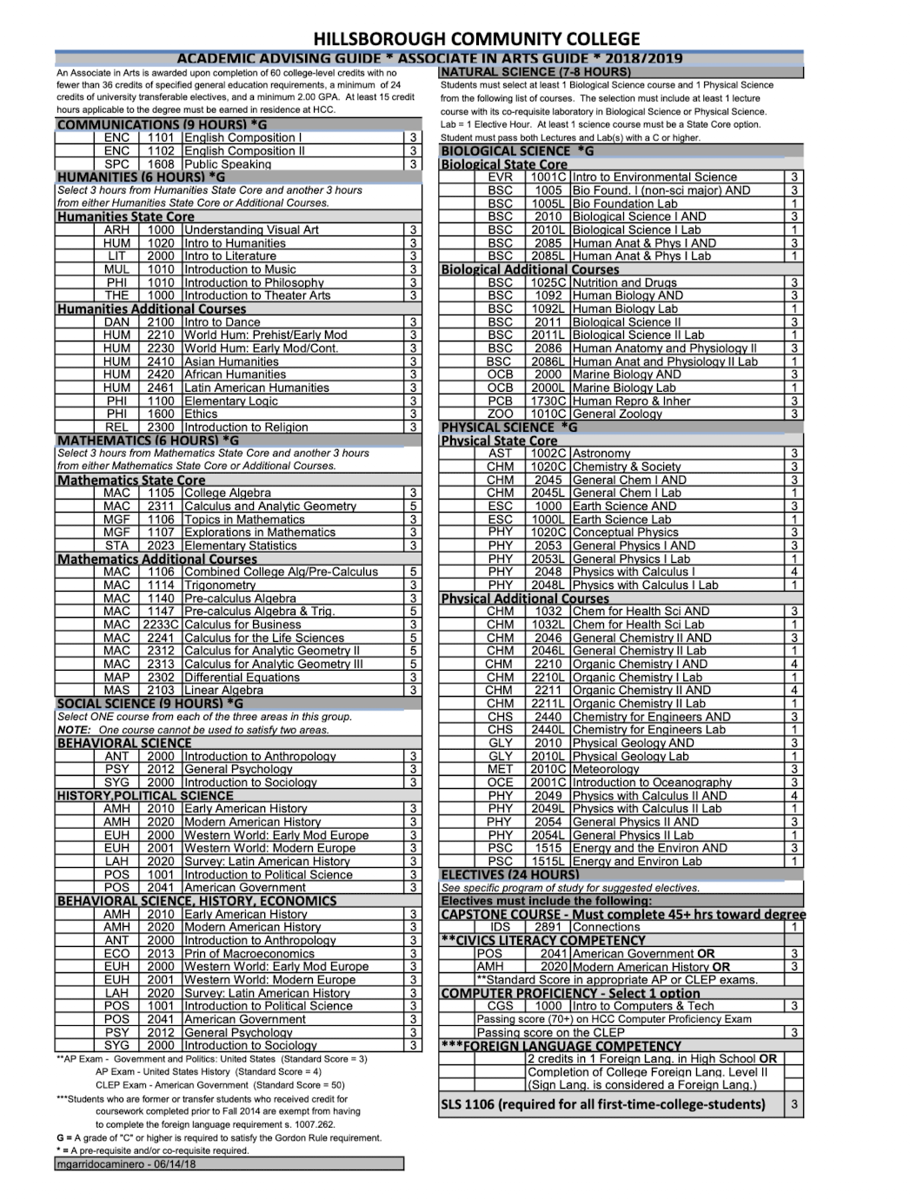

Slide 9
AICE/AP
AICE Scores
Passing AICE English Language will give you credit for ENC 1101
Passing AICE English Literature will give you credit for ENC 1102
Passing AICE Psychology will give you credit for PSY 2012.
Any other AICE Classes that you pass will count towards HCC elective credit.
AP Scores
The only AP classes currently offered at Leto are AP Precalculus, AP Calculus AB/BC, and AP Spanish Literature, all of which only count for HCC elective credit.

Slide 10
High School Equivalent
AMH 2010 or AMH 2020 gives you U.S. History Credit
POS-2041 gives you Government Credit
ECO-2013 or ECO-2023 gives you Economics Credit

Slide 11
Finding Classes
Look for General Education courses offered
Check handout for classes at HCC offered for this degree
Search for classes (HCC site)
Look for classes offered at HCC for each term
Read Syllabus
Check how the class is formatted, and see if it’s the right fit for you
Rate my Professor
Check ratings of your professor to see if they’re the right fit

Slide 12
Signing up for classes
https://dph6m.notion.site/Dual-Enrollment-Classes-Form-b-5d3baff1b9894e90b125c81c2d8c705b?pvs=4

Slide 13
Ordering textbooks
Textbook ordering for DE students

Slide 14
Checking progress
WebAdvisor
HawkGPS
Manually

